Slide 1
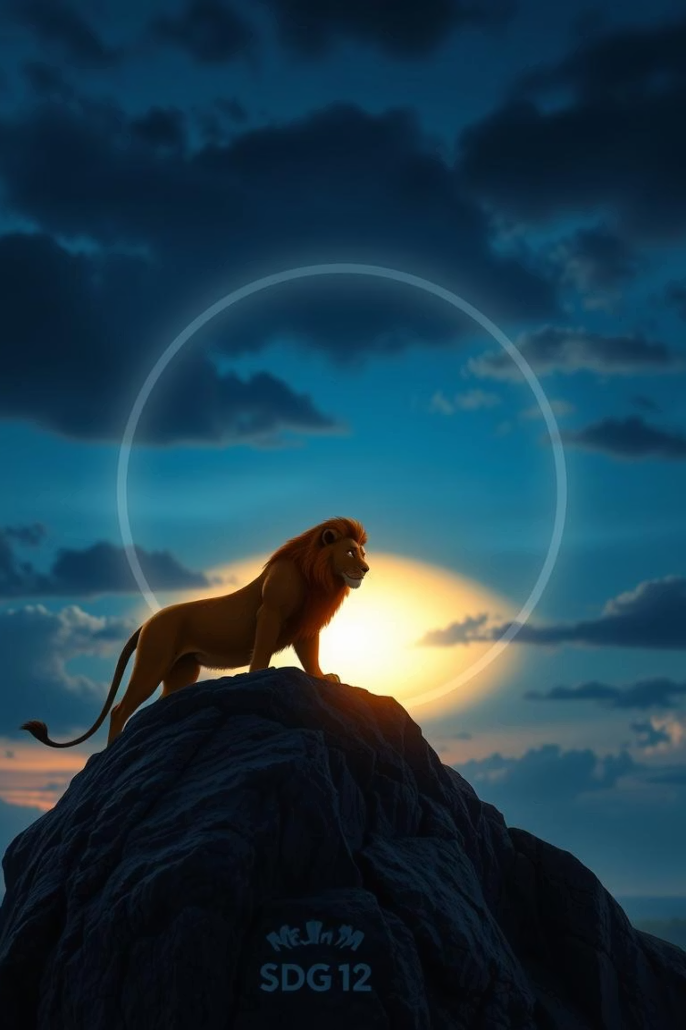
The Lion King (1994) & SDG 12
Sustainable Consumption & Production
Theme: Responsible Use of Resources (Circle of Life)
ENG101 Final Presentation — Fall 2025
Presented by: Dewan Hisam • Abib Hasan • Safir Ahbab • Imam Hossain
Section: 02

Slide 2
Plot Summary (Key Events)
Simba's Birth & Destiny
1
Simba is born, destined to be the future king of the Pride Lands, celebrated by all creatures.
2
Mufasa's Wisdom
King Mufasa teaches Simba about the delicate "Circle of Life" and responsible stewardship.
Scar's Betrayal
3
Mufasa's envious brother, Scar, plots to usurp the throne, leading to tragedy.
4
Tragedy & Exile
Mufasa dies in a stampede orchestrated by Scar, and a guilt-ridden Simba flees the Pride Lands.
Scar's Tyranny
5
Under Scar's rule, the Pride Lands suffer from overuse and neglect, leading to ecological collapse.
6
Simba's New Life
Simba grows up in exile with Timon and Pumbaa, living a carefree life.
Call to Duty
7
Nala and Rafiki remind Simba of his true identity and his duty to reclaim his place.
8
Return & Restoration
Simba returns to challenge Scar, defeats him, and restores balance to the Pride Lands.
A New Beginning
9
Simba becomes king, and the Pride Lands flourish once more under his responsible leadership.

Slide 3
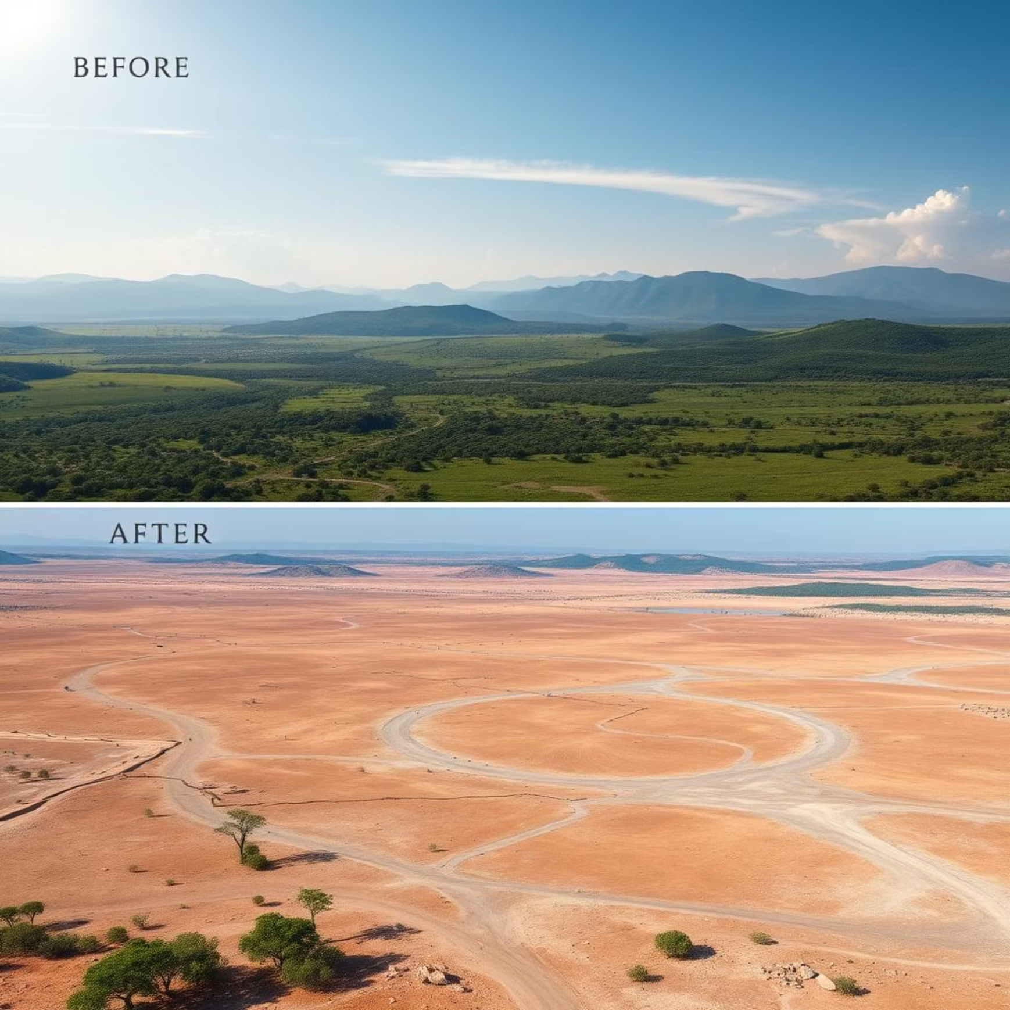
How the Movie Connects to SDG 12
Circle of Life
Represents balanced consumption, renewal, and the interconnectedness of nature.
Responsible Leadership
Mufasa embodies stewardship and sustainable living, ensuring resources for all.
Scar’s Rule
Symbolizes unsustainable practices: greed, overuse, and misuse of resources.
Pride Lands Decline
Illustrates the environmental and social consequences of irresponsible governance.
Restoration
Highlights how sustainability enables recovery, resilience, and a flourishing ecosystem.
Keywords: sustainability • balance • resilience • accountability

Slide 4



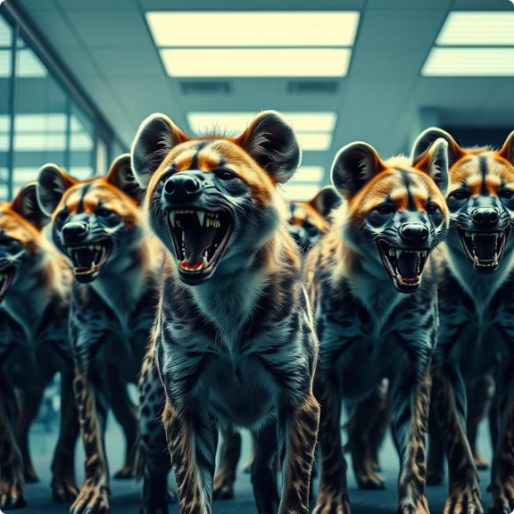
Character Analysis (SDG Lens)
Simba
Mufasa
Scar
Hyenas
Journey from fear to responsibility; learns the true meaning of stewardship, building resilience and adaptability as a leader.
Wise leadership protecting the delicate balance of nature; his legacy teaches sustainable governance and resource management.
Driven by greed and envy, he exploits resources without thought for the future, leading to moral and ecological decay.
Represent uncontrolled, short-term consumption, blindly supporting destruction for immediate gratification without self-restraint.

Slide 5

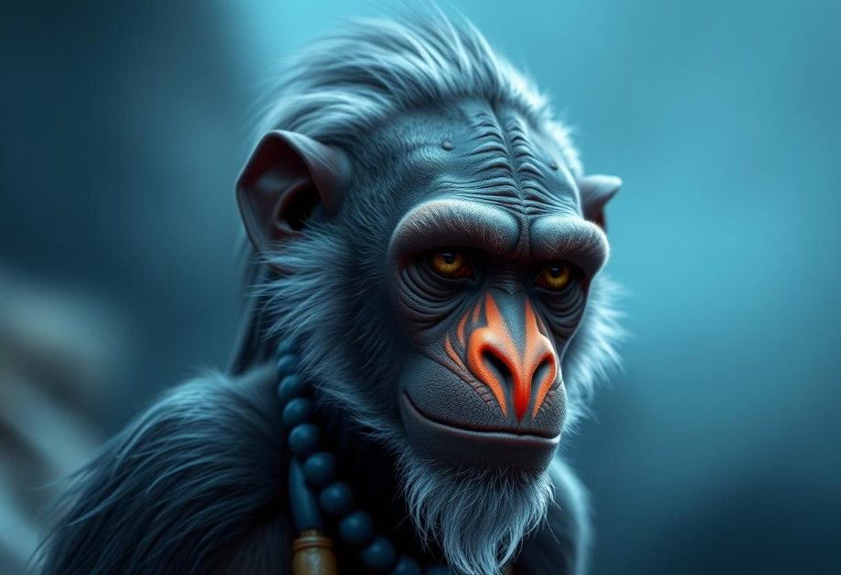

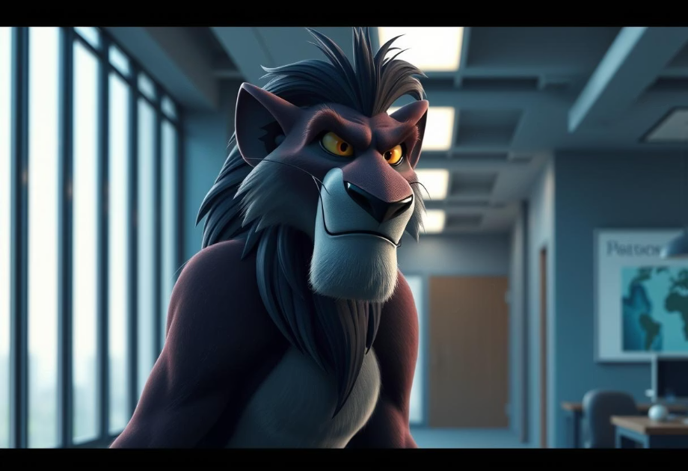

Dialogue Analysis (Impact & Message)
“The past can hurt… you can either run from it, or learn from it.”
“Everything exists together in a delicate balance.”
“Run away, Simba… and never return.”
Impact: Highlights that sustainability is fundamentally dependent on maintaining ecological and social equilibrium.
Impact: Illustrates manipulation and the avoidance of responsibility, leading to detrimental outcomes for the community.
Impact: Emphasizes accountability and the necessity to change behavior for a sustainable future.

Slide 6


Constructive Solution 1 — Responsible Use of Resources
Conscious Consumption
Consume only what is truly needed, avoiding excess and waste.
Environmental Balance
Actively work to maintain the delicate balance of ecosystems.
Waste Reduction
Embrace practices of reuse & recycle to minimize environmental impact.
Resource Efficiency
Utilize natural resources efficiently, reducing depletion and pollution.
Ecosystem Protection
Protect and preserve ecosystems for the benefit of future generations.

Slide 7
Constructive Solution 2 — Sustainable Leadership & Long-Term Thinking
Environmentally Responsible Leadership
Adopt leadership principles that prioritize ecological well-being and sustainability in all decisions.
Respect Environmental Limits
Recognize and operate within the planet's ecological boundaries to prevent irreversible damage.
Prioritize Long-Term Sustainability
Focus on strategies that ensure the health and viability of resources for generations to come, rather than immediate gains.
Avoid Short-Term Exploitation
Resist practices that lead to quick profits at the expense of environmental degradation or social injustice.
Restore and Protect Ecosystems
Actively engage in initiatives that restore damaged environments and protect existing biodiversity.
Keywords: stewardship • resilience • long-term planning

Slide 8

Conclusion
Thank You
We appreciate your time and attention and hope this presentation offered new insights into environmental stewardship.
Any Questions?
Movie: The Lion King (1994) • SDG 12 icon: UN

